Slide 1

SHARE MARKET ANALYSIS CAPSTONE PROJECT

Slide 2
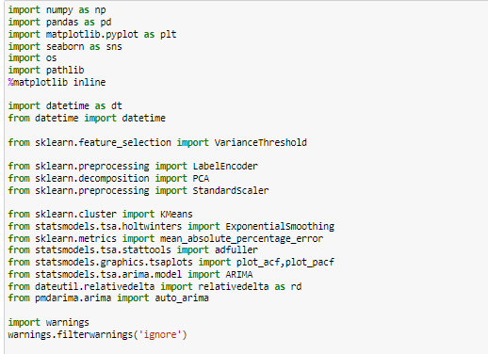
Import the required Libraries

Slide 3
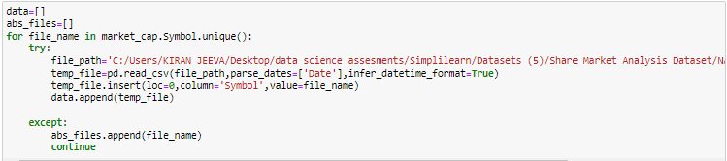
Loading the csv file into a DataFrame (df)
Append files

Slide 4
Include the fields Market cap and Last sale in addition to the various metrics in Nasdaq100 metrics
Identify the variables whose variance is less than .005 (as these do not contribute to model building), and eliminate those variables

Slide 5

Delete the variables in nasdaq100_metrics_ratios.xlsx where 30% or more of the values are missing
Perform missing value imputation for variables with less than 30% missing values by considering the company's sector

Slide 6
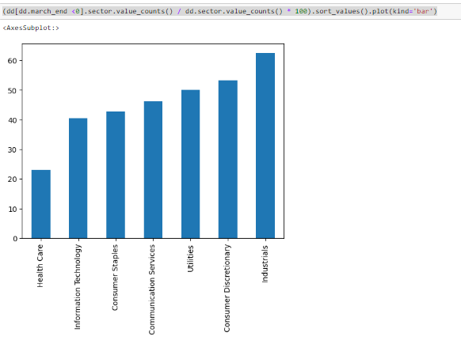
Visualisations

Slide 7
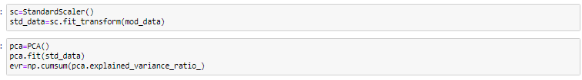
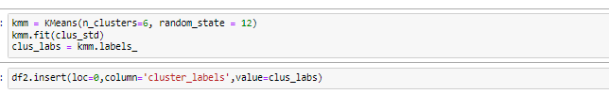
Perform PCA to reduce the number of variables in the data
Identify cohorts

Slide 8
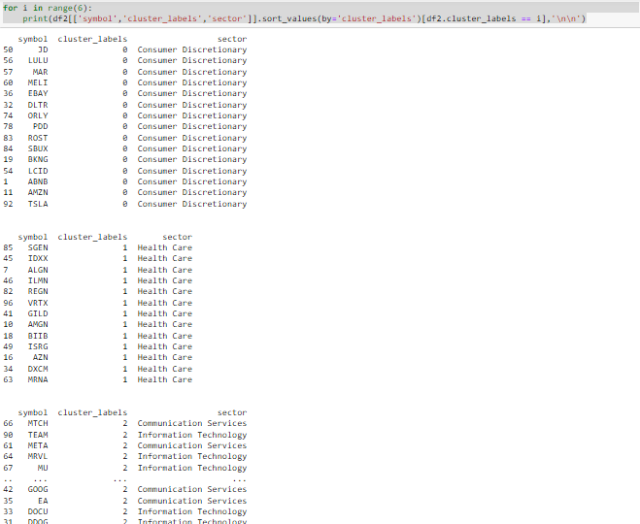
Highlight companies from different sectors falling into the same cohort,

Slide 9
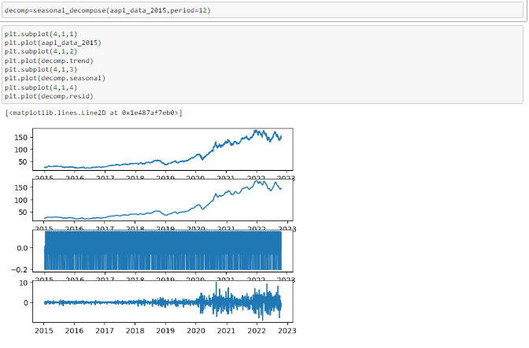
Plot seasonality, trend, and irregular components over time for the historical stock price of Apple

Slide 10
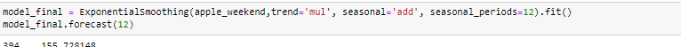
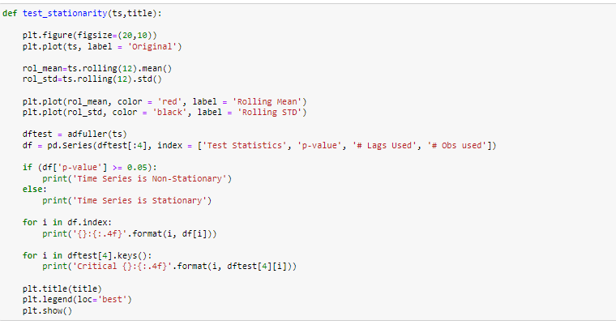
Based on trend and seasonality, choose an appropriate exponential smoothing method to forecast the weekend share price value for the next 12 months
Perform an augmented Dickey–Fuller test (ADF) to check for the stationarity of Apple stock.

Slide 11
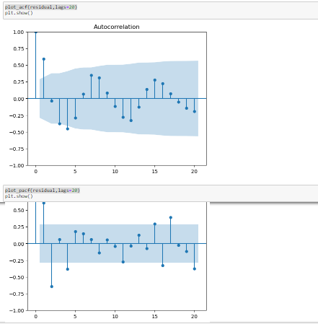
p, d, and q

Slide 12
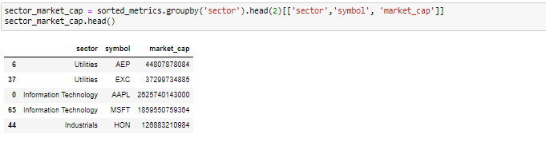
Find the mean absolute percentage error (MAPE) for a 12-month period to validate the model
Identify the top 2 companies

Slide 13
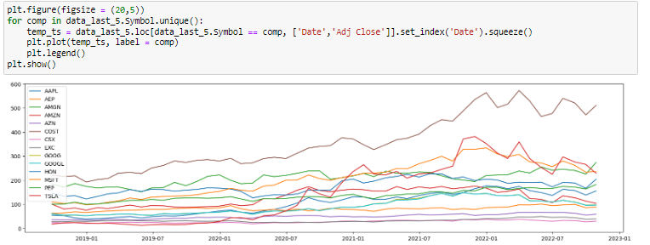
Conduct an ADF test to verify the stationarity of the companies selected in the previous step

Slide 14
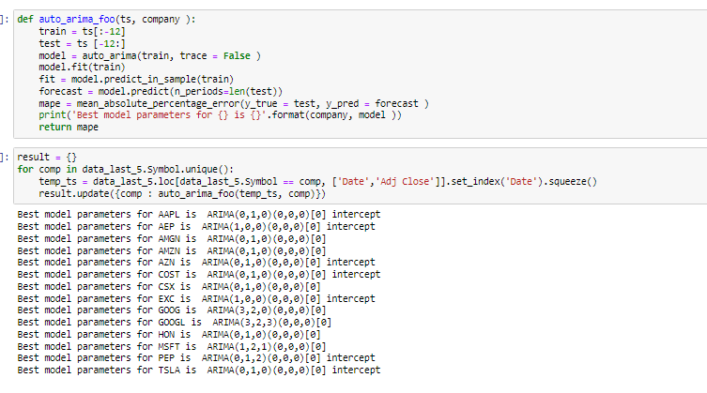
Perform batch forecasting for the top 2 companies from each sector based on market capitalization for the weekend share price value for the next 12 months using Auto ARIMA, and find the MAPE for a 12-month period to validate the model

Slide 15
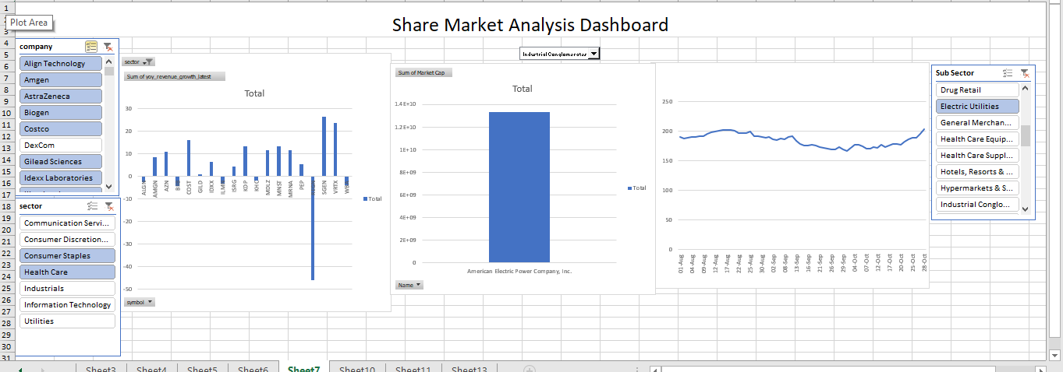
EXCEL DASHBOARD

Slide 16
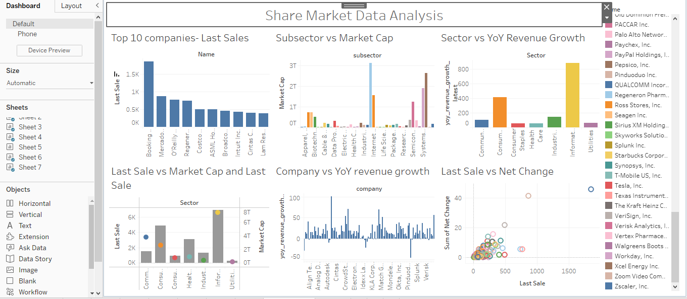
TABLEAU DASHBOARD

Slide 17
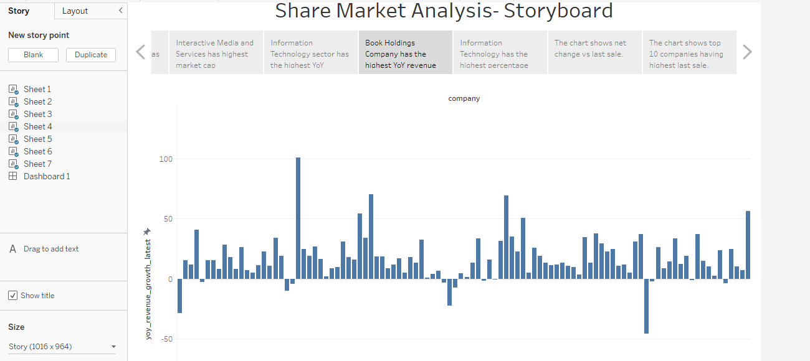
TABLEAU STORYBOARD

Slide 18
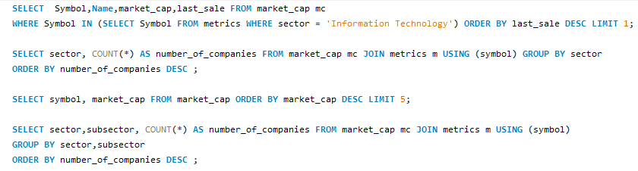
SQL Queries

